Slide 1
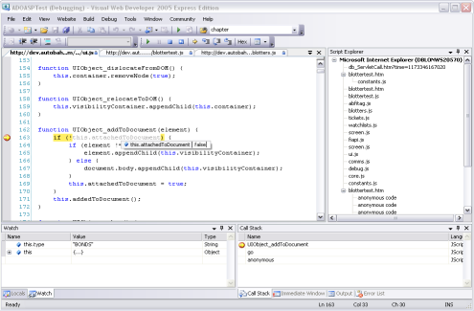
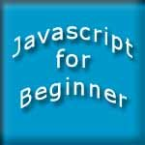

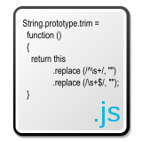

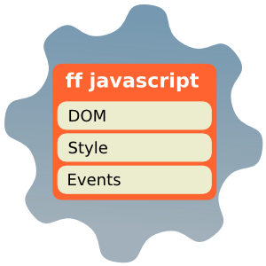

Introduction to JavaScript
Alexander Vakrilov
Telerik Corporation
www.telerik.com

Slide 2


Table of Contents
What is DHTML?
DHTML Technologies
XHTML, CSS, JavaScript, DOM
Introduction to JavaScript
What is JavaScript
Implementing JavaScript into Web pages
In <head> part
In <body> part
In external .js file

Slide 3
Table of Contents (2)
JavaScript Syntax
JavaScript operators
JavaScript Data Types
JavaScript Pop-up boxes
alert, confirm and prompt
Conditional and switch statements, loops and functions

Slide 4
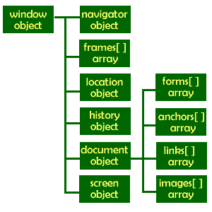

Table of Contents (2)
Document Object Model
DOM Event Model
The Built-In Browser Objects
Debugging in JavaScript

Slide 5


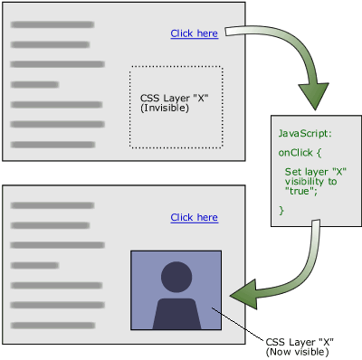
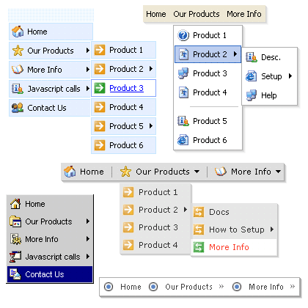
DHTML
Dynamic Behavior at the Client Side

Slide 6
What is DHTML?
Dynamic HTML (DHTML)
Makes possible a Web page to react and change in response to the user’s actions
DHTML = HTML + CSS + JavaScript
DHTML
XHTML
CSS
JavaScript
DOM

Slide 7
DTHML = HTML + CSS + JavaScript
HTML defines Web sites content through semantic tags (headings, paragraphs, lists, …)
CSS defines 'rules' or 'styles' for presenting every aspect of an HTML document
Font (family, size, color, weight, etc.)
Background (color, image, position, repeat)
Position and layout (of any object on the page)
JavaScript defines dynamic behavior
Programming logic for interaction with the user, to handle events, etc.

Slide 8
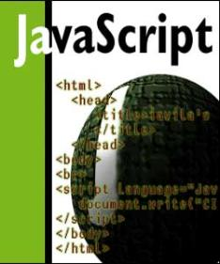


JavaScript
Dynamic Behavior in a Web Page

Slide 9
JavaScript
JavaScript is a front-end scripting language developed by Netscape for dynamic content
Lightweight, but with limited capabilities
Can be used as object-oriented language
Client-side technology
Embedded in your HTML page
Interpreted by the Web browser
Simple and flexible
Powerful to manipulate the DOM

Slide 10
JavaScript Advantages
JavaScript allows interactivity such as:
Implementing form validation
React to user actions, e.g. handle keys
Changing an image on moving mouse over it
Sections of a page appearing and disappearing
Content loading and changing dynamically
Performing complex calculations
Custom HTML controls, e.g. scrollable table
Implementing AJAX functionality

Slide 11
What Can JavaScript Do?
Can handle events
Can read and write HTML elements and modify the DOM tree
Can validate form data
Can access / modify browser cookies
Can detect the user’s browser and OS
Can be used as object-oriented language
Can handle exceptions
Can perform asynchronous server calls (AJAX)

Slide 12
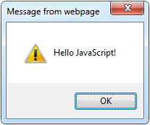
The First Script
first-script.html
<html>
<body>
<script type="text/javascript">
alert('Hello JavaScript!');
</script>
</body>
</html>

Slide 13
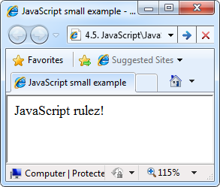
Another Small Example
small-example.html
<html>
<body>
<script type="text/javascript">
document.write('JavaScript rulez!');
</script>
</body>
</html>

Slide 14
Using JavaScript Code
The JavaScript code can be placed in:
<script> tag in the head
<script> tag in the body
External files, linked via <script> tag the head
Files usually have .js extension
Highly recommended
The .js files get cached by the browser
<script src="scripts.js" type="text/javscript">
<!– code placed here will not be executed! -->
</script>

Slide 15
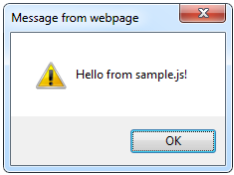
Using External Script Files
Using external script files:
External JavaScript file:
<html>
<head>
<script src="sample.js" type="text/javascript">
</script>
</head>
<body>
<button onclick="sample()" value="Call JavaScript
function from sample.js" />
</body>
</html>
external-JavaScript.html
The <script> tag is always empty.
function sample() {
alert('Hello from sample.js!')
}
sample.js

Slide 16
JavaScript – When is Executed?
JavaScript code is executed during the page loading or when the browser fires an event
All statements are executed at page loading
Some statements just define functions that can be called later
Function calls or code can be attached as "event handlers" via tag attributes
Executed when the event is fired by the browser
<img src="logo.gif" onclick="alert('clicked!')" />

Slide 17
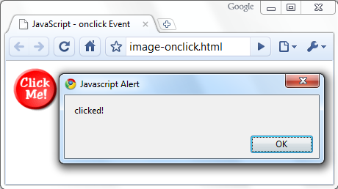
Calling a JavaScript Function from Event Handler – Example
<html>
<head>
<script type="text/javascript">
function test (message) {
alert(message);
}
</script>
</head>
<body>
<img src="logo.gif"
onclick="test('clicked!')" />
</body>
</html>
image-onclick.html

Slide 18
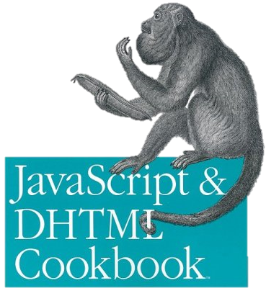
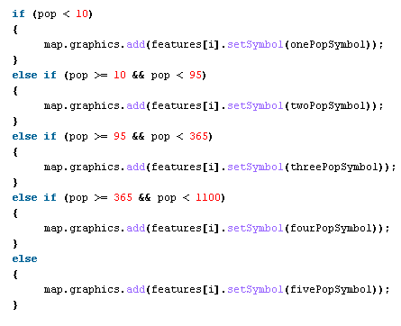

The JavaScript Syntax

Slide 19
JavaScript Syntax
The JavaScript syntax is similar to C# and Java
Operators (+, *, =, !=, &&, ++, …)
Variables (typeless)
Conditional statements (if, else)
Loops (for, while)
Arrays (my_array[]) and associative arrays (my_array['abc'])
Functions (can return value)
Function variables (like the C# delegates)

Slide 20
Data Types
JavaScript data types:
Numbers (integer, floating-point)
Boolean (true / false)
String type – string of characters
Arrays
Associative arrays (hash tables)
var myName = "You can use both single or double quotes for strings";
var my_array = [1, 5.3, "aaa"];
var my_hash = {a:2, b:3, c:"text"};

Slide 21
Everything is Object
Every variable can be considered as object
For example strings and arrays have member functions:
objects.html
var test = "some string";
alert(test[7]); //) shows letter 'r'
alert(test.charAt(5); // shows letter 's'
alert("test".charAt(1)); //shows letter 'e'
alert("test".substring(1,3)); //shows 'es'
var arr = [1,3,4];
alert (arr.length); // shows 3
arr.push(7); // appends 7 to end of array
alert (arr[3]); // shows 7

Slide 22
String Operations
The + operator joins strings
What is "9" + 9?
Converting string to number:
string1 = "fat ";
string2 = "cats";
alert(string1 + string2); // fat cats
alert("9" + 9); // 99
alert(parseInt("9") + 9); // 18

Slide 23
Primitive values
NaN and Infinity
null and undefined
undefined - primitive value used when a variable has not been assigned a value.
The null - primitive value that represents the null, empty, or non-existent reference.
parseInt("doncho"); // NaN
var x = "doncho" * 10; // NaN
var y = 10 / 0; // Infinity

Slide 24
Arrays Operations and Properties
Declaring new empty array:
Declaring an array holding few elements:
Appending an element / getting the last element:
Reading the number of elements (array length):
Finding element's index in the array:
var arr = new Array();
var arr = [1, 2, 3, 4, 5];
arr.push(3);
var element = arr.pop();
arr.length;
arr.indexOf(1);

Slide 25
Standard Popup Boxes
Alert box with text and [OK] button
Just a message shown in a dialog box:
Confirmation box
Contains text, [OK] button and [Cancel] button:
Prompt box
Contains text, input field with default value:
alert("Some text here");
confirm("Are you sure?");
prompt ("enter amount", 10);

Slide 26
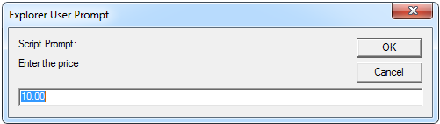
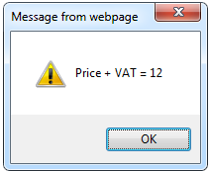
JavaScript Prompt – Example
prompt.html
price = prompt("Enter the price", "10.00");
alert('Price + VAT = ' + price * 1.2);

Slide 27
Sum of Numbers – Example
sum-of-numbers.html
<html>
<head>
<title>JavaScript Demo</title>
<script type="text/javascript">
function calcSum() {
value1 =
parseInt(document.mainForm.textBox1.value);
value2 =
parseInt(document.mainForm.textBox2.value);
sum = value1 + value2;
document.mainForm.textBoxSum.value = sum;
}
</script>
</head>

Slide 28
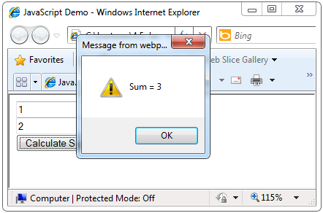
Sum of Numbers – Example (2)
sum-of-numbers.html (cont.)
<body>
<form name="mainForm">
<input type="text" name="textBox1" /> <br/>
<input type="text" name="textBox2" /> <br/>
<input type="button" value="Process"
onclick="javascript: calcSum()" />
<input type="text" name="textBoxSum"
readonly="readonly"/>
</form>
</body>
</html>

Slide 29
Conditional Statement (if)
unitPrice = 1.30;
if (quantity > 100) {
unitPrice = 1.20;
}
Symbol
Meaning
>
Greater than
<
Less than
>=
Greater than or equal to
<=
Less than or equal to
==
Equal
!=
Not equal

Slide 30

Conditional Statement (if) (2)
The condition may be of Boolean or integer type:
conditional-statements.html
var a = 0;
var b = true;
if (typeof(a)=="undefined" || typeof(b)=="undefined") {
document.write("Variable a or b is undefined.");
}
else if (!a && b) {
document.write("a==0; b==true;");
} else {
document.write("a==" + a + "; b==" + b + ";");
}

Slide 31
Switch Statement
The switch statement works like in C#:
switch (variable) {
case 1:
// do something
break;
case 'a':
// do something else
break;
case 3.14:
// another code
break;
default:
// something completely different
}
switch-statements.html

Slide 32
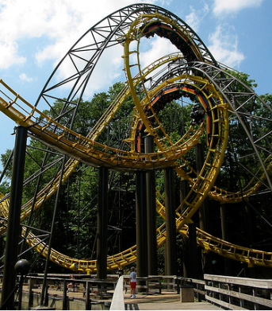

Loops
Like in C#
for loop
while loop
do … while loop
var counter;
for (counter=0; counter<4; counter++) {
alert(counter);
}
while (counter < 5) {
alert(++counter);
}
loops.html

Slide 33
Functions
Code structure – splitting code into parts
Data comes in, processed, result returned
Parameters come in here.
function average(a, b, c)
{
var total;
total = a+b+c;
return total/3;
}
Declaring variables is optional. Type is never declared.
Value returned here.

Slide 34
Function Arguments and Return Value
Functions are not required to return a value
When calling function it is not obligatory to specify all of its arguments
The function has access to all the arguments passed via arguments array
function sum() {
var sum = 0;
for (var i = 0; i < arguments.length; i ++)
sum += parseInt(arguments[i]);
return sum;
}
alert(sum(1, 2, 4));
functions-demo.html

Slide 35
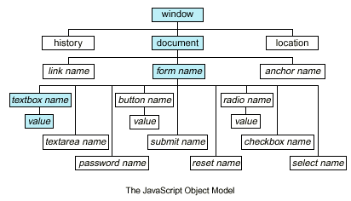
Document Object Model (DOM)

Slide 36
Document Object Model (DOM)
Every HTML element is accessible via the JavaScript DOM API
Most DOM objects can be manipulated by the programmer
The event model lets a document to react when the user does something on the page
Advantages
Create interactive pages
Updates the objects of a page without reloading it

Slide 37
Accessing Elements
Access elements via their ID attribute
Via the name attribute
Via tag name
Returns array of descendant <img> elements of the element "el"
var elem = document.getElementById("some_id")
var arr = document.getElementsByName("some_name")
var imgTags = el.getElementsByTagName("img")

Slide 38
DOM Manipulation
Once we access an element, we can read and write its attributes
DOM-manipulation.html
function change(state) {
var lampImg = document.getElementById("lamp");
lampImg.src = "lamp_" + state + ".png";
var statusDiv =
document.getElementById("statusDiv");
statusDiv.innerHTML = "The lamp is " + state";
}
…
<img src="test_on.gif" onmouseover="change('off')"
onmouseout="change('on')" />

Slide 39
Common Element Properties
Most of the properties are derived from the HTML attributes of the tag
E.g. id, name, href, alt, title, src, etc…
style property – allows modifying the CSS styles of the element
Corresponds to the inline style of the element
Not the properties derived from embedded or external CSS rules
Example: style.width, style.marginTop, style.backgroundImage

Slide 40
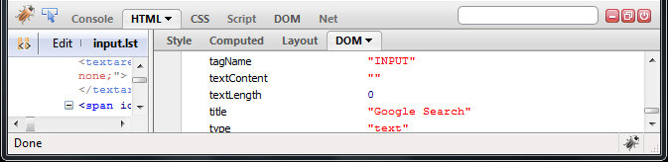
Common Element Properties (2)
className – the class attribute of the tag
innerHTML – holds all the entire HTML code inside the element
Read-only properties with information for the current element and its state
tagName, offsetWidth, offsetHeight, scrollHeight, scrollTop, nodeType, etc…

Slide 41
Accessing Elements through the DOM Tree Structure
We can access elements in the DOM through some tree manipulation properties:
element.childNodes
element.parentNode
element.nextSibling
element.previousSibling
element.firstChild
element.lastChild

Slide 42
Accessing Elements through the DOM Tree – Example
var el = document.getElementById('div_tag');
alert (el.childNodes[0].value);
alert (el.childNodes[1].
getElementsByTagName('span').id);
…
<div id="div_tag">
<input type="text" value="test text" />
<div>
<span id="test">test span</span>
</div>
</div>
accessing-elements-demo.html
Warning: may not return what you expected due to Browser differences

Slide 43
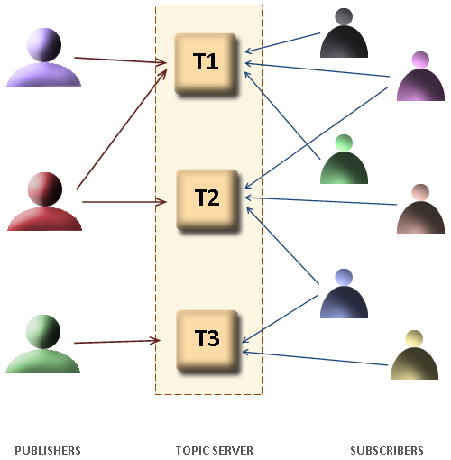
The HTML DOM Event Model

Slide 44
The HTML DOM Event Model
JavaScript can register event handlers
Events are fired by the Browser and are sent to the specified JavaScript event handler function
Can be set with HTML attributes:
Can be accessed through the DOM:
<img src="test.gif" onclick="imageClicked()" />
var img = document.getElementById("myImage");
img.onclick = imageClicked;

Slide 45
The HTML DOM Event Model (2)
All event handlers receive one parameter
It brings information about the event
Contains the type of the event (mouse click, key press, etc.)
Data about the location where the event has been fired (e.g. mouse coordinates)
Holds a reference to the event sender
E.g. the button that was clicked

Slide 46

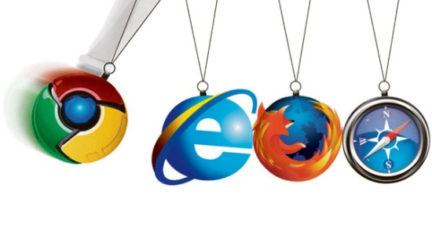
The HTML DOM Event Model (3)
Holds information about the state of [Alt], [Ctrl] and [Shift] keys
Some browsers do not send this object, but place it in the document.event
Some of the names of the event’s object properties are browser-specific

Slide 47
Common DOM Events
Mouse events:
onclick, onmousedown, onmouseup
onmouseover, onmouseout, onmousemove
Key events:
onkeypress, onkeydown, onkeyup
Only for input fields
Interface events:
onblur, onfocus
onscroll

Slide 48
Common DOM Events (2)
Form events
onchange – for input fields
onsubmit
Allows you to cancel a form submission
Useful for form validation
Miscellaneous events
onload, onunload
Allowed only for the <body> element
Fires when all content on the page was loaded / unloaded

Slide 49
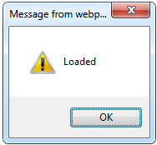
onload Event – Example
onload event
onload.html
<html>
<head>
<script type="text/javascript">
function greet() {
alert("Loaded.");
}
</script>
</head>
<body onload="greet()" >
</body>
</html>

Slide 50

The Built-In Browser Objects

Slide 51
Built-in Browser Objects
The browser provides some read-only data via:
window
The top node of the DOM tree
Represents the browser's window
document
holds information the current loaded document
screen
Holds the user’s display properties
browser
Holds information about the browser

Slide 52
DOM Hierarchy – Example
window
navigator
screen
document
history
location
form
form
button
form

Slide 53
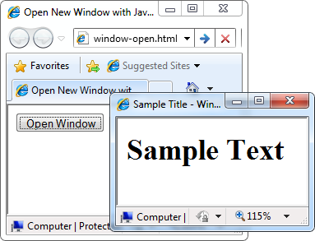
Opening New Window – Example
window.open()
window-open.html
var newWindow = window.open("", "sampleWindow",
"width=300, height=100, menubar=yes,
status=yes, resizable=yes");
newWindow.document.write(
"<html><head><title>
Sample Title</title>
</head><body><h1>Sample
Text</h1></body>");
newWindow.status =
"Hello folks";

Slide 54
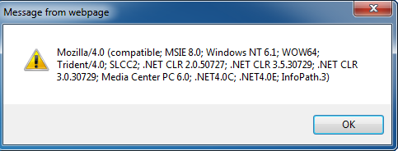
The Navigator Object
alert(window.navigator.userAgent);
The browser window
The navigator in the browser window
The userAgent (browser ID)

Slide 55

The Screen Object
The screen object contains information about the display
window.moveTo(0, 0);
x = screen.availWidth;
y = screen.availHeight;
window.resizeTo(x, y);

Slide 56
Document and Location
document object
Provides some built-in arrays of specific objects on the currently loaded Web page
document.location
Used to access the currently open URL or redirect the browser
document.links[0].href = "yahoo.com";
document.write(
"This is some <b>bold text</b>");
document.location = "http://www.yahoo.com/";

Slide 57
Form Validation – Example
form-validation.html
function checkForm()
{
var valid = true;
if (document.mainForm.firstName.value == "") {
alert("Please type in your first name!");
document.getElementById("firstNameError").
style.display = "inline";
valid = false;
}
return valid;
}
…
<form name="mainForm" onsubmit="return checkForm()">
<input type="text" name="firstName" />
…
</form>

Slide 58
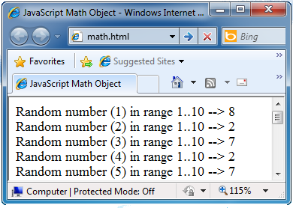
The Math Object
The Math object provides some mathematical functions
math.html
for (i=1; i<=20; i++) {
var x = Math.random();
x = 10*x + 1;
x = Math.floor(x);
document.write(
"Random number (" +
i + ") in range " +
"1..10 --> " + x +
"<br/>");
}

Slide 59
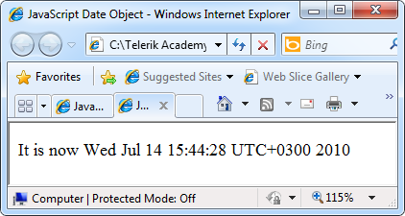
The Date Object
The Date object provides date / calendar functions
dates.html
var now = new Date();
var result = "It is now " + now;
document.getElementById("timeField")
.innerText = result;
...
<p id="timeField"></p>

Slide 60
Timers: setTimeout()
Make something happen (once) after a fixed delay
var timer = setTimeout('bang()', 5000);
5 seconds after this statement executes, this function is called
clearTimeout(timer);
Cancels the timer

Slide 61
Timers: setInterval()
Make something happen repeatedly at fixed intervals
var timer = setInterval('clock()', 1000);
This function is called continuously per 1 second.
clearInterval(timer);
Stop the timer.

Slide 62
Timer – Example
timer-demo.html
<script type="text/javascript">
function timerFunc() {
var now = new Date();
var hour = now.getHours();
var min = now.getMinutes();
var sec = now.getSeconds();
document.getElementById("clock").value =
"" + hour + ":" + min + ":" + sec;
}
setInterval('timerFunc()', 1000);
</script>
<input type="text" id="clock" />

Slide 63

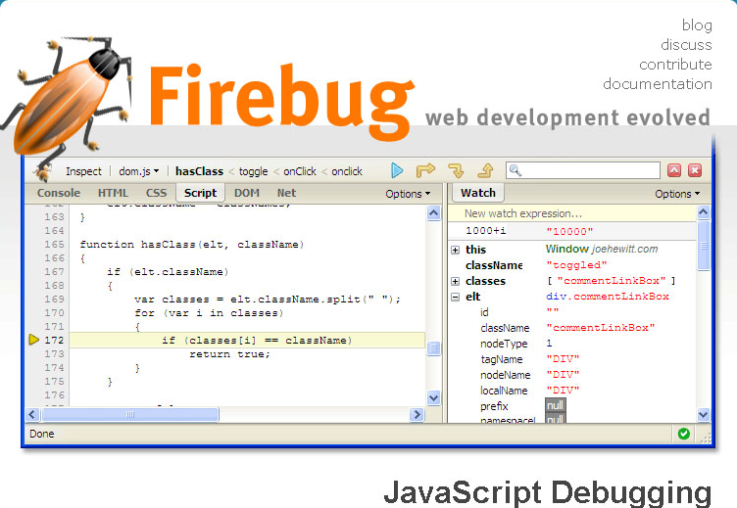
Debugging JavaScript

Slide 64
Debugging JavaScript
Modern browsers have JavaScript console where errors in scripts are reported
Errors may differ across browsers
Several tools to debug JavaScript
Microsoft Script Editor
Add-on for Internet Explorer
Supports breakpoints, watches
JavaScript statement debugger; opens the script editor

Slide 65
Firebug
Firebug – Firefox add-on for debugging JavaScript, CSS, HTML
Supports breakpoints, watches, JavaScript console editor
Very useful for CSS and HTML too
You can edit all the document real-time: CSS, HTML, etc
Shows how CSS rules apply to element
Shows Ajax requests and responses
Firebug is written mostly in JavaScript

Slide 66
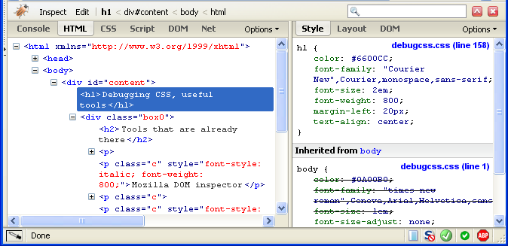
Firebug (2)

Slide 67
JavaScript Console Object
The console object exists only if there is a debugging tool that supports it
Used to write log messages at runtime
Methods of the console object:
debug(message)
info(message)
log(message)
warn(message)
error(message)

Slide 68
Introduction to JavaScript
?
?
?
?
?
Questions?
?
?
?
?
?
?

Slide 69
Homework
Create an HTML page that has two text fields (first name and last name) and a button. When the user clicks the button, a message should show the text in the text fields followed by the current time.
Create a Web page that asks the user about his name and says goodbye to him when leaving the page.
Modify the previous HTML page to have a text field for email address and on clicking the button check if the email is valid (it should follow the format <something>@<host>.<domain>).
Create a Web page that shows 20 <div> elements with random location, size and color.

Slide 70
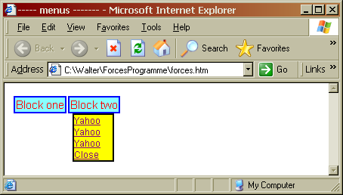
Homework (2)
Create a drop-down menu
Use table for the main menu blocks
Use hidden <DIV> elements (display: none; position:absolute; top:30px)
Use JavaScript and onmouseover and onmouseout event to change display: none/block

Slide 71
Homework (3)
Create a DTHML page that has <div> containing a text that scrolls from right to left automatically
Use setInterval() function to move the text at an interval of 500 ms
Use overflow:hidden for the <div>
Use scrollLeft and scrollWidth properties of the <div> element

